Slide 1

SOEN 6441 : Advance Programming Practices (Winter-2016)
Tower Defense Game Supervisor: Dr. Joey Paquet
Submitted by: TEAM-2
Alaa Sabah - 27835647 Lokesh Parappurath - 27299680 Iftikhar Ahmad - 26854605 Muhammad Umer - 40015021

Slide 2
INTRODUCTION
The basic idea of Tower Defense Game is to destroy moving critters in a specific path using some towers. The game consist of a map which has a start point and end point and also has a path connecting both. There is a map editor to create new maps or edit existing maps. The game starts by selecting the map and user can place towers anywhere on the scenery.
The game is developed as a desktop application using the MVC architecture implemented using Observer pattern design. The game has 2 views:
MapEditor: For creating and editing maps for the game.
GameWindow: For playing the game.
The business logic of the game is handled by the model classes.

Slide 3
Functional Requirements
The functional requirements for deliverable 1st of the game include:
User driven interactive creation of a map as a grid of user-defined dimension.
User-driven allocation of grid elements such as scenery, path, entry point and exit point.
Saving a map to a file.
Loading a map from an existing file, then editing the map.
Verification of map correctness before saving.
Game starts by selecting a saved map, then loads the map
User-driven placing of towers on the map, following the game’s restrictions
Implementation of currency and cost to buy or sell a tower
Implementation of towers’ level-dependent characteristics such as level, cost to increase level, refund rate, range, power, rate of fire, special effects, etc.
Tower inspection window that shows its current characteristics.
Tower inspection window allows to sell the tower.
Tower inspection window allows to increase the level of a tower, changing its characteristics.

Slide 4
Architectural Design
Architectural Design
The architecture of our system adopts the widely used Model-View-Controller (MVC) architecture, this model is chosen for our project since its architectural pattern separates the representation of information from the user's interaction with it that is the source code has no reference to the Controller or the view. As a result, a clear separation of concern between the logic, data and presentation is achieved. There are many advantages of highly cohesive software architecture such as maintainable system where modifying one component doesn’t necessarily require changing the other components. In addition, MVC architecture is useful for developing in a team environment because it allows the three components to be developed simultaneously allowing for a very flexible and rapid development.
A model notifies its associated views and controllers of state changes. This notification allows the views to produce updated interface, and the controllers to change the available set of commands.
A view registers the controller to receive user interface events and requests from the model the information that it needs to generate an output representation.

Slide 5
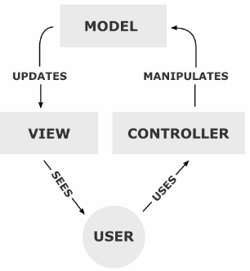
Architectural Design
A controller handles the user`s input and can send commands to its associated view to change the view's presentation of the model. When the change is purely cosmetic we update the view.

Slide 6
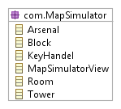
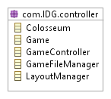
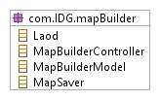

Subsystems Design
These are the packages in the system and their related classes

Slide 7
UML Class diagram for MVC Architecture
package: com.IDG.mapSimulator

Slide 8
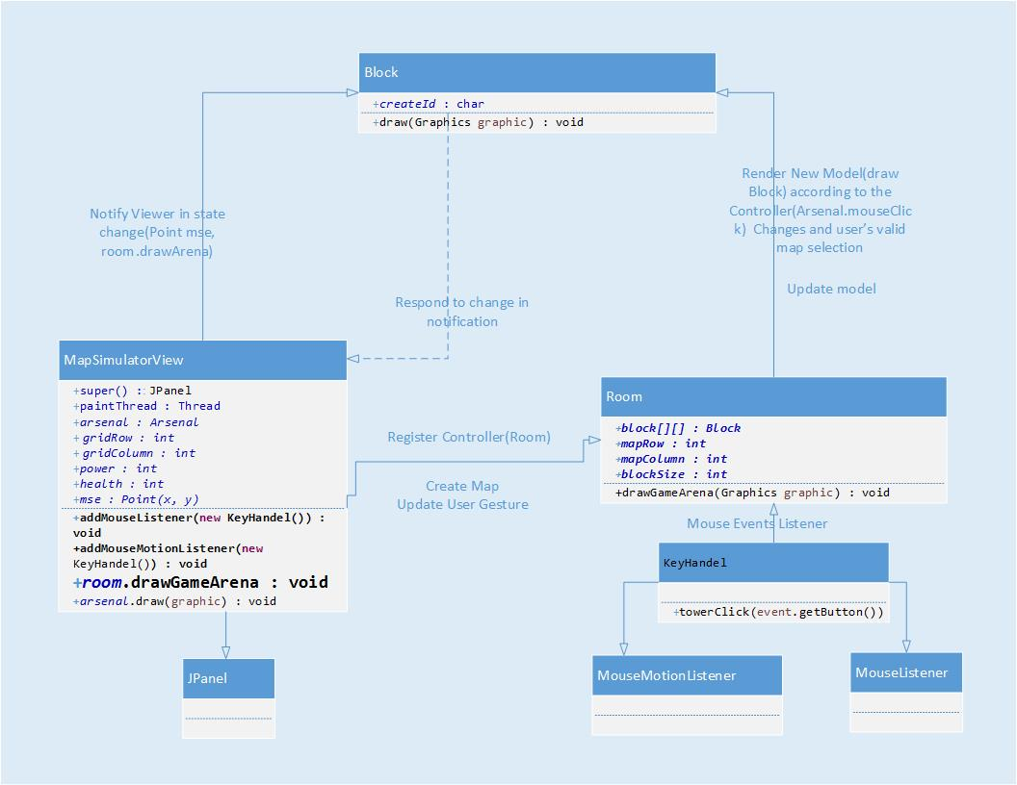
UML Class diagram for MVC Architecture

Slide 9
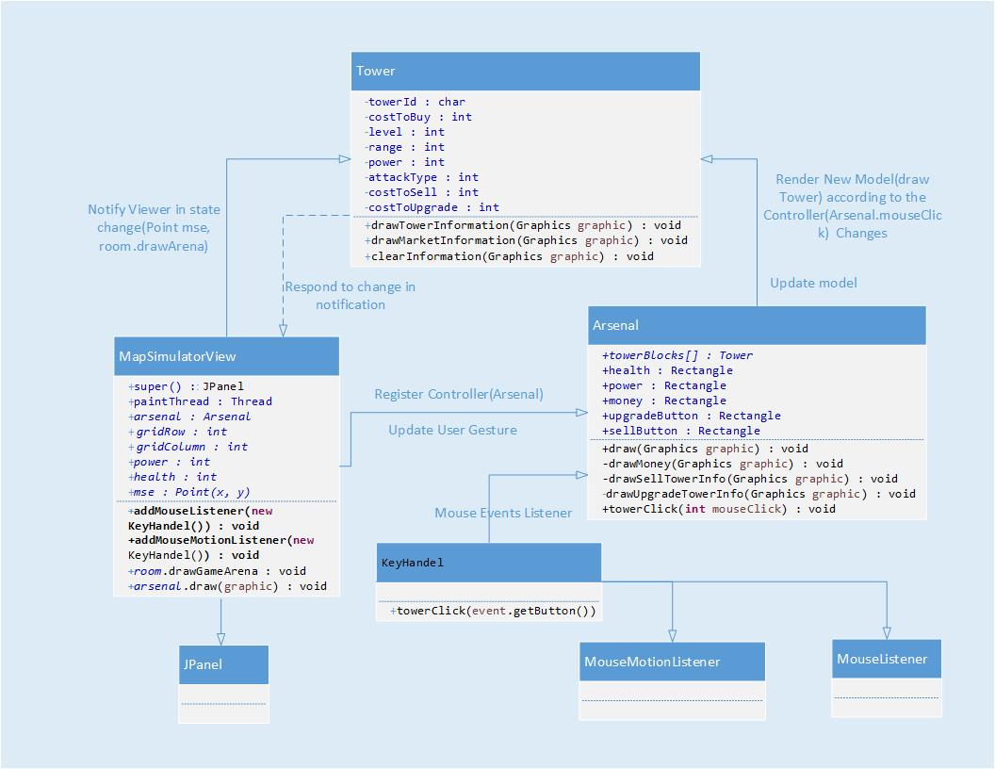
UML Class diagram for MVC Architecture

Slide 10
Testing
Unit testing applied to our system is the JUnit Framework for the Java Programming Language. Since its time consuming to test all the methods in the system as the large number of methods in our system is large, only selected sets of methods were tested and the method chosen test the most important aspects of the code.

Slide 11
Agile Methodology
Agile methodologies embrace iterations.
Small teams work together with stakeholders
Proof of concepts, or the problem to be solved.
The team defines the requirements for the iteration, develops the code, and runs integrated test scripts.
The users verify the results.
Two agile software development methodologies
1) XP
Extreme programming concentrates on the development rather than managerial aspects of software project
It start with a release planning phase, followed by several iterations.
When the product has enough features to satisfy users, the team terminates iteration
and releases the software.
2) Scrum development
The Scrum development process concentrates on managing sprints. Before each sprint begins, the team plans the sprint, identifying the backlog items and assigning teams to these items. Teams develop, wrap, review, and adjust each of the backlog items

